Slide 1
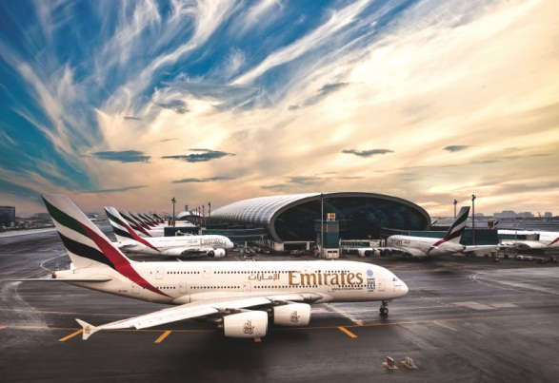
Emirates: A Choice Airline for Québec Exporters
Don McWilliam – Country Manager - Canada
May 16th, 2017

Slide 2
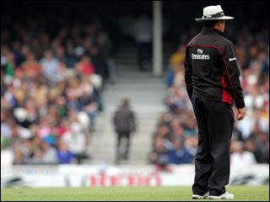
Emirates Overview
One of the world’s fastest growing, and the largest airline by international RPKs
Exclusively operating modern wide-body fleet of 239 passenger aircraft and 15 freighters
Aircraft on order – 243 at a total value of USD 116 billion
Largest operator of Airbus A380 and Boeing 777
153 destinations in 81 countries across 6 continents
Global hub structure, connecting over 4,000 logical city pairs through Emirates’ own metal operation
More than 420 daily flights from Dubai
Over 62,000 staff from over 165 countries
Largest non-aligned airline, leveraging commercial cooperation to enhance network coverage with any carrier regardless of alliance groups

Slide 3
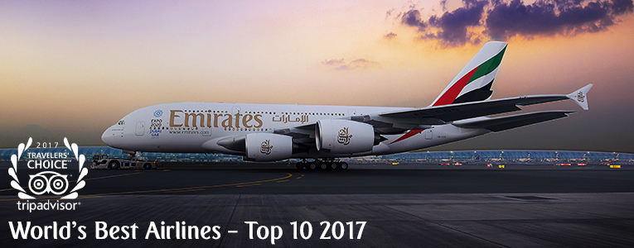
Emirates Accolades
Since its inception, Emirates has won more than 500 international awards.
Recent recognition includes:
TripAdvisor : 2017 Travelers’ Choice Awards – “Best Airline in the World”, “Best Major Airline – Middle East & Africa”, “Best Economy Class”, “Best First Class”, “World’s Best Airlines – Top 10”
Skytrax: “World’s Best Airline 2016”
Skytrax: “Best Airline Inflight Entertainment 2016” (12th consecutive year)
Skytrax: “Best Airline Inflight Entertainment 2015”
Brand Finance: “Most Valuable Airline Brand 2014”
Virtuoso: “Best Airline 2014”
Condé Nast Traveller: “Best Longhaul Airline 2013”
Skytrax: “World’s Best Airline 2013”
Skytrax: “Best Middle Eastern Airline 2013”
Globe Travel Awards: “Best Airline 2013”

Slide 4
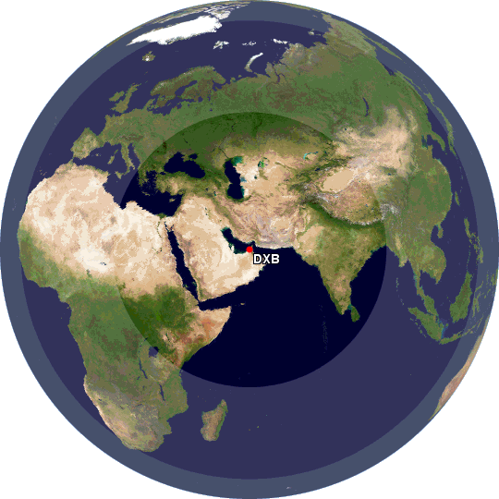
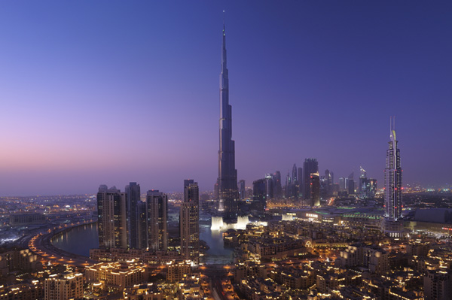
Emirates 2020
WHY EMIRATES?
The strategic location of Dubai makes it possible for Emirates to serve almost 90% of the world’s population with non-stop flights. Hence, Emirates continues to invest in advanced long-haul aircraft.
Over a third of the world’s population lives within a 4-hour flight from Dubai, and two-thirds are within an 8-hour flight.
Dubai International Airport doubling from 24.8 million in 2005 to 47.2 million in 2010
Expo 2020
7 billion
people
8hr Flight
5.7 billion
people
4hr Flight

Slide 5
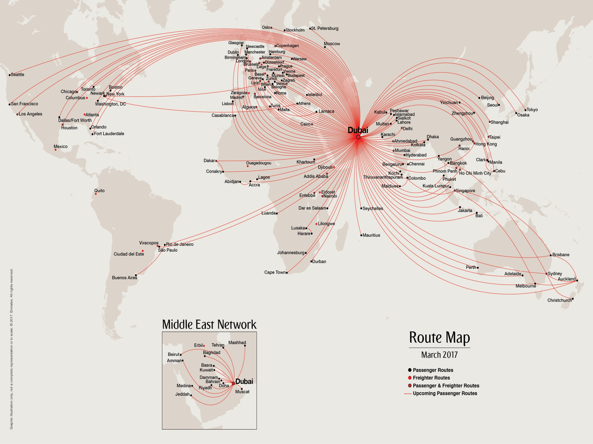
Notes:
This route map clearly demonstrates Emirates’ ability to help MICE planners connect
Emirates makes it easy to bring people from all over the world to Dubai
Our unique regional connections ensure fuss free travel no matter where in the world a delegate is located
Take for example a Fortune 500 company with staff all around the globe
I cannot think of a more centrally located destination, that offers the right facilities, the right hotels at all price points, a great all year round climate and importantly the connectivity to get delegates there in just one stop

Slide 6
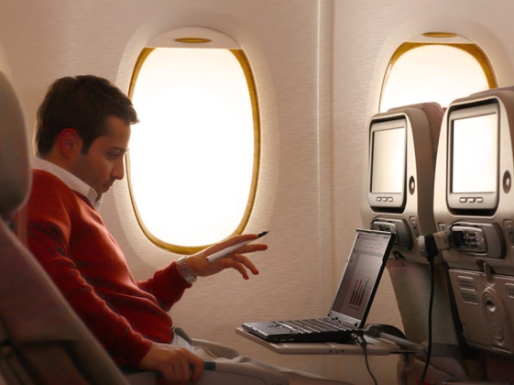
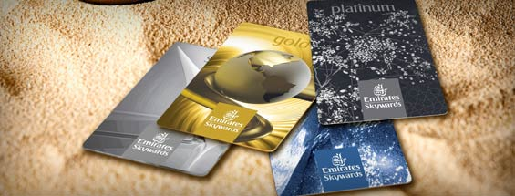
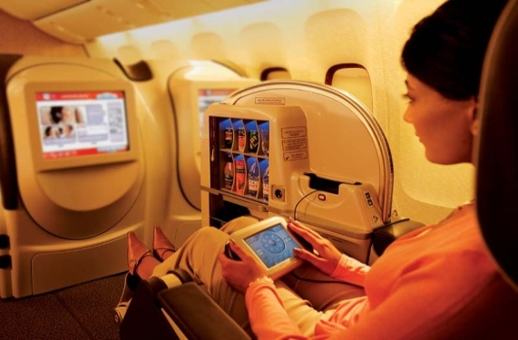
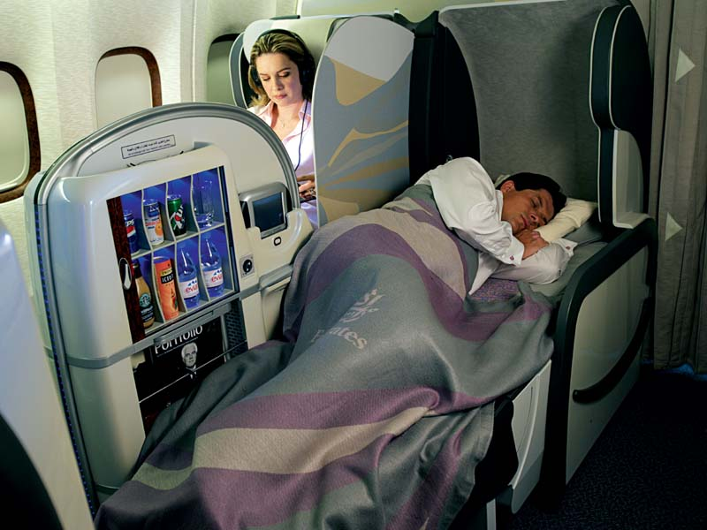
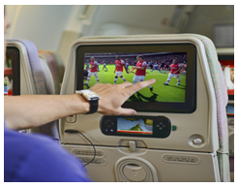
Insight into Innovation
32 across network + 6 in DXB
Special product for children
Stay connected: Wi-Fi
We believe anything is possible
Skywards
No of Channels on ICE >2,200
Fully flat beds
ice TV Live
Shower Spas
Chauffeur-drive service

Slide 7
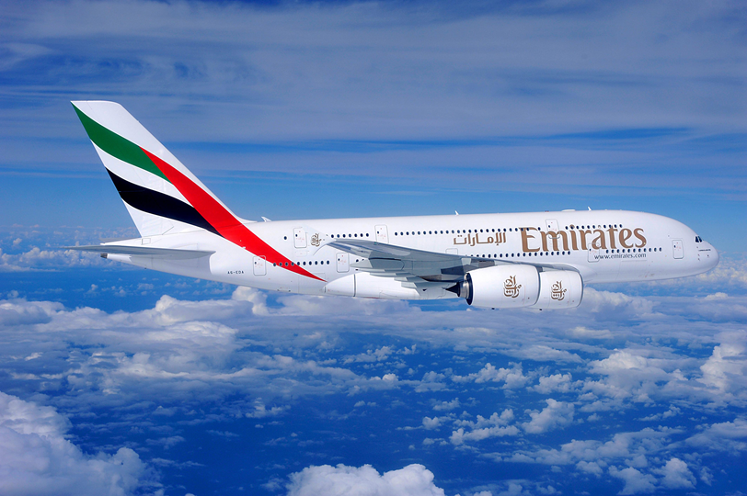
The Emirates A380
CONFIGURATION – THREE CLASS
14 First Class Private Suites and 2 First Class Shower Spas
76 full-flat Business Class seats with all-aisle access
Up to 427 Economy Class seats
FEATURES & BENEFITS
On-board Lounge (First and Business Class passengers)
The most environmentally advanced aircraft in the sky
Quieter than any other aircraft, inside and outside of the cabin
Onboard Wi-Fi available on all A380 aircraft

Slide 8
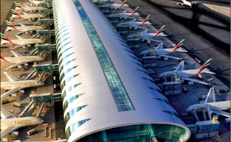
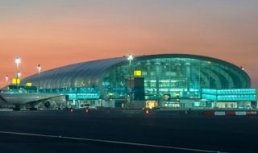
Concourse A: “The Home of the A380”
Concourse A – Opened January 2013, the first and only dedicated A380 facility in the world.
Construction budget of $3 Billion.
91m wide and 645m long with a total area of 528,000m² over 11 floors.
Designed to handle up to 15m passengers annually.
20 gates and related lounges ensuring faster and efficient boarding.
Home to the largest First Class and Business Class lounges in the world.
Fully dedicated to Emirates and Qantas.
Fully airside structure connected to Concourse B and Terminal 3 via underground airport train.

Slide 9
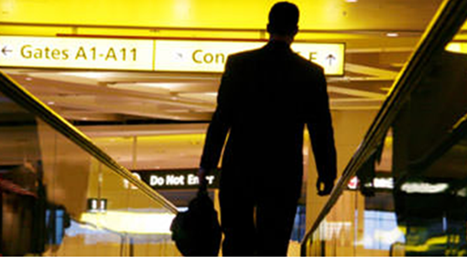
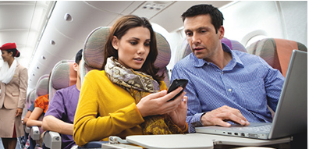
Emirates Added Value Dubai Connect & WiFi
Dubai Connect: Emirates provide complimentary accommodation, meals, ground transportation and covers visa costs where an itinerary calls for a longer stopover in Dubai. First Class and Business Class passengers with a connection time in Dubai of more than six hours & Economy Class passengers with a connection time of more than eight hours but less than 24 hours.
Complimentary Wi-Fi: Connect to our on-board Wi-Fi on almost all Emirates flights. Passengers enjoy the first 10MB of data for free on all our A380s and 777 aircraft. A token USD1 charge is imposed for the next 500MB.

Slide 10
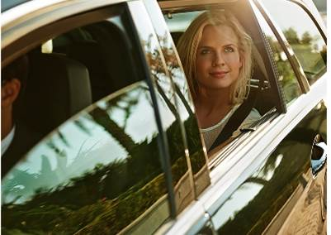
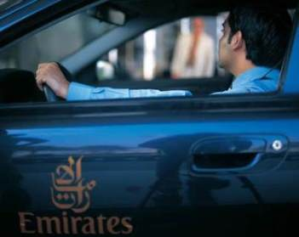
Emirates Chauffeur-Drive Service
First or Business Class travellers can enjoy a complimentary Chauffeur-Drive Service to and from Emirates flight in over 70 cities
Applicable on EK and QF codeshare flights including Canberra, Hobart and Wellington
Can be requested up to 48 hrs. prior to the flight through your GDS system or online via Manage > Before you fly > Chauffeur-drive service
Transfers are available:
From passenger’s home or hotel to the airport
From the airport to the final destination
To and from the airport when making a stopover
To/from Abu Dhabi
New destinations added:
China: Beijing / Shanghai-60km
Stockholm-60 km
Taipei
Boston
Chicago
Orlando

Slide 11
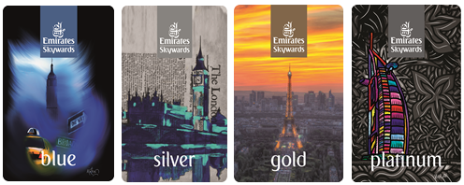
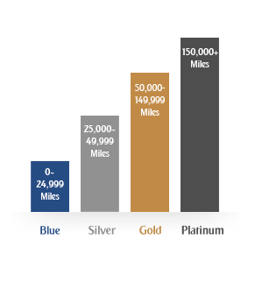
Emirates Skywards Membership Benefits
Complimentary Skywards membership and status matches can be offered based upon account type and revenue potential
Supported by the Emirates Global Sales Managers
Identify travelers whose patterns match our network
Notes:
Know the benefits of Skywards: Dedicated check-in, priority boarding and lounge access.
Do we know who are Skywards members are in our corporate accounts?
Who are our frequent travellers?

Slide 12
Emirates Business Rewards (New!)
Earn Business Rewards Points and Skywards Miles on every flight
Earn 1 Business Rewards Point for every USD 1 spent
Individuals who are already Emirates Skywards members will earn Skywards Miles and Tier Miles at the normal rate
Spend Points your way
Whether you want to book future business travel or reward your employees, you can spend your Business Rewards Points on flights and upgrades on Emirates.
Dynamic Reward Flights are available in every class, and on most Emirates flight
Enjoy a seamless booking experience
You can book your organisation’s via your preferred travel agent (multiple admins)
New ticketing instructions will be sent to your TMCs
In parallel with your global travel agreement (Hybrid)

Slide 13
